Slide 1


Rebecca Vega
19 January 2026

Slide 2


Outline
Executive Summary
Introduction
Methodology
Results
Conclusion
Appendix

Slide 3
Executive Summary
Summary of methodologies
Collected SpaceX launch data via API calls and web scraping
Conducted data wrangling and normalized the datasets for consistency.
Exploratory Data Analysis was conducted via Python visualization and SQL queries
Created maps with Folium and build an interactive dashboard with Plotly Dash.
Applied machine learning models (classification) to forecast launch outcomes.
Summary of all results
Strongest predictors of launch success are booster version and orbit type.
SQL queries reported success rates were site-specific and the influence of payload mass.
EDA visualization revealed clear success patterns across boosters and payload mass.
Folium maps showed geographic distribution of launch sites.
Plotly dashboard provided interactive view of results
Machine learning predictive models achieved up to 83.34% accuracy, which depicts reliable classification of launch outcomes.

Slide 4
Introduction
Project background and context
SpaceX conducts frequent launches with varying success outcomes, and its launch failures are incredibly costly. It also impacts the level of reliability for its commercial and governmental clientele.
Therefore, with data science we can analyze historical data to find factors that influence successful launches, and further use that information to create predictive models to optimize future launches and reduce costs alongside increase confidence in further missions.
Problems that I have set out to answer:
What factors are key to SpaceX’s successful launches?
How do features like payload mass (kg), launch sites, booster versions, etc. affects success/failure rates.
Can EDA, interactive dashboards and maps assist with uncovering patterns in the datasets?
How accurate are machine learning models in making predictions about SpaceX’s launch successes.

Slide 5

Section 1

Slide 6
Methodology
Executive Summary
Data collection methodology:
Data collection was conducted using records from SpaceX’s launch records in a JSON formatted file. Other data was scraped from Wikipedia using Beautiful Soup function.
Perform data wrangling
Data was processed by cleaning missing values, standardizing column names, normalizing categorical variables and new features such as ‘success/failure’ were also engineered.
Perform exploratory data analysis (EDA) using visualization and SQL
Seaborn and Matplotlib were used to visualize success rates by booster version, payload mass (kg), orbit type, and launch sites.
SQL queries were used to filter and average out data of launches for greater insights.
Perform interactive visual analytics using Folium and Plotly Dash
Geographic information such as site distribution were displayed using Folium
Developed a Plotly dashboard with interactivity to display dynamic data in pie charts and scatterplots. It also included dropdown menus and filters for ease of view.
Perform predictive analysis using classification models
Logistic Regression, SVM, K-nearest neighbors, and Decision Tree Classifier was used to predict whether launches would be successful. Hyperparameters were also tuned to optimize performance of the models.
Models were evaluated using a confusion matrix.

Slide 7
Data Collection
Structured data was collected from launch data via SpaceX’s API. I retrieved data such as dates, payload mass, booster versions and outcomes.
Web scraping from Wikipedia was conducted to retrieve supplementary data such as orbit type, site information and further info about the payload mass.
Later the data was integrated in a unified data set.
The unified dataset was saved as a CSV for ease of use.
SPACEX API
Raw JSON data
Unified dataset
(CSV)
Data integration
Web scraping Wikipedia
Supplementary details

Slide 8
Data Collection – SpaceX API
REST API calls: retrieved launch data from SpaceX’s API
Endpoints: /v4/launches, /v4/rockets, /v4/launchpads
Data format: JSON containing payload, booster orbit and success or fail details.
Integration: Converted JSON into dataframe for further data analysis
Storage: Exported cleaned datasets into CSV file.
GitHub URL of the SpaceX API calls notebook: https://github.com/beclyv/Data_Science_Capstone_Project_SpaceX/blob/main/notebooks/01-jupyter-labs-spacex-data-collection-api.ipynb
SpaceX REST API
JSON data
Pandas DataFrame
Cleaned Dataset
CSV Storage

Slide 9
Data Collection – Web Scraping (Wikipedia)
Target source: Wikipedia page containing SpaceX’s launch records.
Tool used: Python’s requests and BeautifulSoup libraries.
Process: Sent HTTP requests, parsed HTML tables and extracted launch details.
Integration: Converted scraped data into structured panda dataframes.
Storage: Exported cleaned tables into CSV files.
GitHub URL of the web scraping notebook: https://github.com/beclyv/Data_Science_Capstone_Project_SpaceX/blob/main/notebooks/02-jupyter-labs-webscraping.ipynb
Wikipedia SpaceX launch page
HTTP Request (requests)
HTML Parsing (BeautifulSoup)
Extracted Tables (orbit, payload, site)
Pandas DataFrame
CSV Storage

Slide 10
Data Wrangling
Data cleaning: Missing values, duplicates, and unnecessary columns were removed.
Normalization: standardized payload mass units and categorical labels such as booster versions and orbit types.
Feature engineering: Created new variables like success/failure, payload categories, booster classifications.
Integration: API data and data scraped from Wikipedia was merged into a unified dataset
Final dataset: Structured data exported into CSV format.
GitHub URL of the data wrangling related notebooks: https://github.com/beclyv/Data_Science_Capstone_Project_SpaceX/blob/main/notebooks/03-labs-jupyter-spacex-Data%20wrangling.ipynb
Raw data (API + Web scraping)
Cleaning (remove nulls, duplicates)
Normalization (units, categories)
Feature engineering (new variables)
Integration (merge datasets)
Final structured dataset (CSV)

Slide 11
EDA with Data Visualization
Charts plotted:
Bar charts: Used to compare categorical variables (booster, site, orbit) to identify strongest predictors of success.
Scatter plots: Used to visualize the relationships between payload mass and success probability.
Pie charts: Showed proportional breakdown of orbits
Line charts: Illustrated the temporal trends and improvements in success rates.
Heatmaps: Summarize feature correlations to guide model creation.
GitHub URL of EDA with data visualization notebook: https://github.com/beclyv/Data_Science_Capstone_Project_SpaceX/blob/main/notebooks/05-jupyter-labs-eda-dataviz.ipynb

Slide 12
EDA with SQL
Identified number of launch sites: Counted distinct launch sites from the dataset.
Ranked landing outcomes: Ordered landing outcomes within a given time period in descending order.
Analyzed failures by month: Queried failure landing outcomes on drone ships, grouped by month and booster outcome.
Found maximum payload boosters: Used subqueries to identify boosters that carried the heaviest payloads.
Retrieved milestone dates: Listed the date of the first successful ground pad landing.
Filtered by conditions: Applied WHERE clauses to isolate specific outcomes (e.g., drone ship landings, payload ranges).
Aggregated success/failure counts: Summarized launch outcomes for comparison across sites and boosters.
Temporal analysis: Queried launches by year/month to observe changes in landing success.
Applied joins: Combined tables (launches, payloads, boosters) to enrich analysis.
Derived insights: Used SQL logic to uncover operational patterns and performance milestones.
GitHub URL of EDA with SQL notebook: https://github.com/beclyv/Data_Science_Capstone_Project_SpaceX/blob/main/notebooks/04-jupyter-labs-eda-sql-coursera_sqllite.ipynb

Slide 13
Build an Interactive Map with Folium
Map objects in folium map:
Markers: Placed at each launch site to pinpoint geographic location. Provides clear identification and quick access to site-specific information.
Popups: Added to markers to display the site names and launch details when clicked or hovered over.
Circles and circle markers: Used to represent launch outcomes (fail/success) with color coding (green= success, red= failure). Visualizes success and failure in a color-coded way.
Lines: Connected to launch sites to show distance between site and other geographic locations like cities. Highlights distance from sites to nearby landmarks.
Clustered markers: Grouped nearby launches to reduce clutter and improve readability.
GitHub URL of interactive map with Folium map: https://github.com/beclyv/Data_Science_Capstone_Project_SpaceX/blob/main/notebooks/06-lab_jupyter_launch_site_location.jupyterlite.ipynb
Note: Map on lab is not interactive because it is on GitHub. It is advised to download the file and view it on VSCode if you wish to review the interactivity. I have also included a folder with the screenshots of the map as evidence of the maps and markers and included the github link: https://github.com/beclyv/Data_Science_Capstone_Project_SpaceX/tree/main/folium%20maps

Slide 14
Build a Dashboard with Plotly Dash
Plots/Graphs
Pie chart: Shows success vs. failure outcomes by launch site.
Scatter plot: Displays payload mass vs. launch outcome, color‑coded by booster version category.
Interactions included
Dropdown menu: Filters data by launch site (or shows all sites).
Range slider: Adjusts payload mass range dynamically to explore success probabilities.
Hover tooltips: Provide detailed launch info (payload, orbit, booster) when hovering over points.

Slide 15
Build a Dashboard with Plotly Dash
Why these were added
Pie chart: Simplifies categorical comparisons of success/failure across sites.
Scatter plot: Reveals relationships between payload mass and success outcomes.
Dropdown and Slider: Allow users to interactively explore different scenarios instead of static plots.
Hover tooltips: Enhance usability by giving extra context without cluttering the chart.
Purpose: Build a dynamic, user‑friendly dashboard for exploring SpaceX launch success factors.
GitHub URL of Plotly Dash lab: https://github.com/beclyv/Data_Science_Capstone_Project_SpaceX/blob/main/notebooks/07-lab-spacex-dash-app.py

Slide 16
Predictive Analysis (Classification)
Model Evaluation
Calculated accuracy on test data using method.
Plotted confusion matrices to visualize misclassifications.
Compared validation accuracy across models.
Model Selection
Selected the best performing model based on balanced accuracy and confusion matrix results.
Highlighted why it outperformed others (e.g., better generalization, fewer misclassifications).

Slide 17
Predictive Analysis (Classification)
Data preparation
GitHub URL of completed predictive analysis lab: https://github.com/beclyv/Data_Science_Capstone_Project_SpaceX/blob/main/notebooks/08-SpaceX-Machine-Learning-Prediction-Part-5-v1.ipynb
Train/test split (18 test samples)
Build models (Logistic regression, SVM, KNN, Decision Tree)
GridSearch CV (hyperparameter tuning, cv=10)
Evaluate (best_score_, test accuracy, confusion matrix)
Compare models
Select best performing model
17

Slide 18
Results: EDA Analysis
Launch success over time: Success rates improved steadily with higher flight numbers, showing operational maturity.
Payload mass impact: Even heavy payloads were successfully launched, indicating robust booster recovery systems.
Launch site performance: KSC LC‑39A and CCAFS SLC‑40 handled heavier payloads with higher success rates compared to other sites.
Orbit type reliability: Certain orbits (GEO, SSO, ES‑L1) achieved near‑perfect success, while GTO showed lower reliability.
Temporal trend: Yearly success rates rose sharply after 2015, peaking above 90% in 2019, reflecting technological advancements.
Feature insights: Flight number, payload mass, launch site, and orbit type emerged as strong predictors for classification modeling.

Slide 19
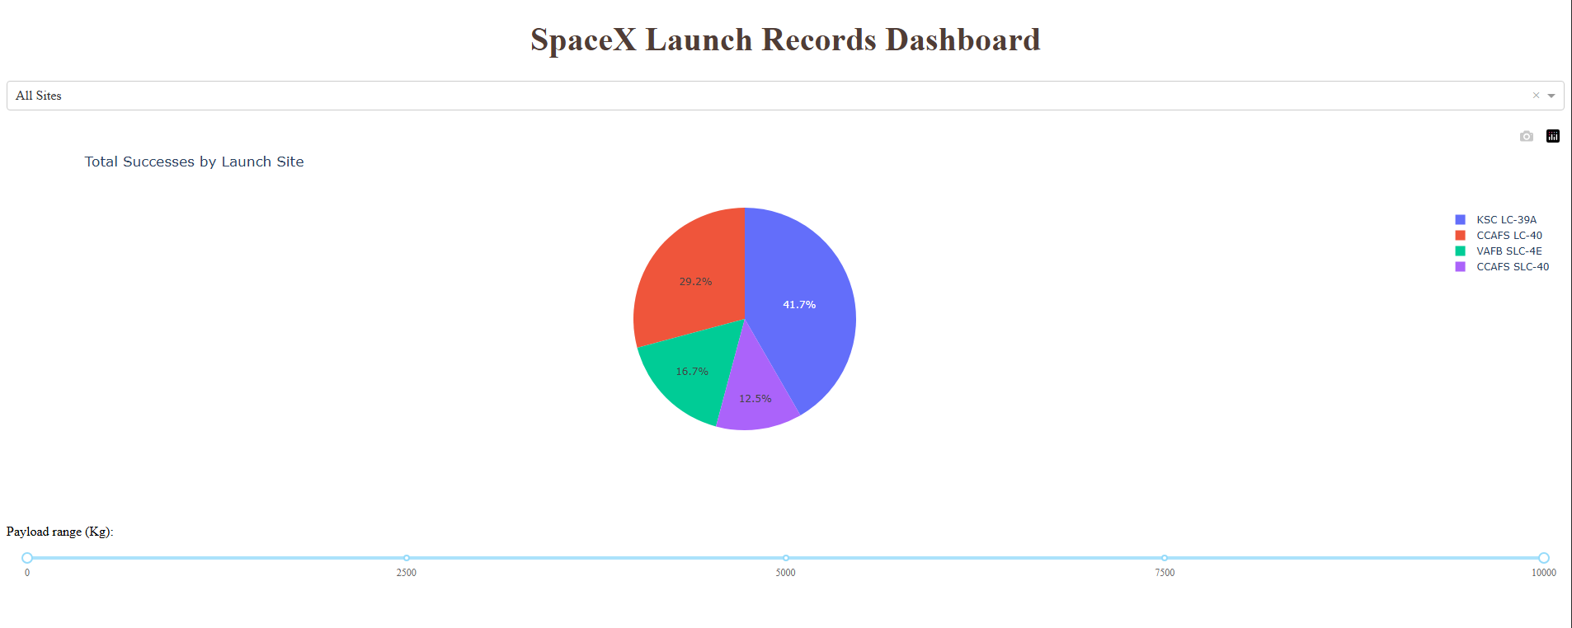
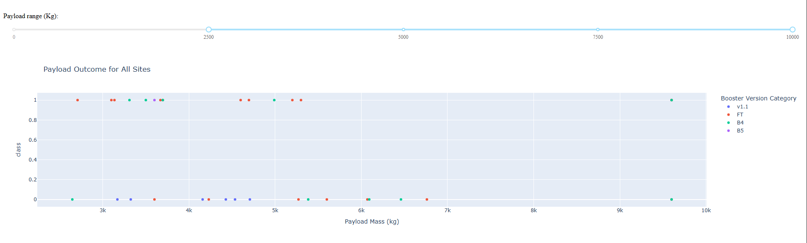
Results: Interactive analytics
Screenshots of interactive dashboard.
Pie chart is shown with a dropdown menu that has all the names of the launch sites.
Payload mass slider corresponds with the scatter plot chart.

Slide 20
Results: Predictive analysis
Models: Logistic Regression, SVM, KNN, Decision Tree.
Hyperparameter tuning: GridSearchCV applied with 10‑fold cross‑validation to optimize parameters.
Validation (GridSearchCV) accuracy: Decision Tree 0.875; SVM 0.8482; KNN 0.8482; Logistic 0.8464.
Test accuracy (18 samples): Decision Tree 0.9444; Logistic 0.8333; SVM 0.8333; KNN 0.8333.
Confusion matrices (test set):
Logistic / SVM / KNN: TN = 3, FP = 3, FN = 0, TP = 12.
Decision Tree: TN = 5, FP = 1, FN = 0, TP = 12
Best model selection: Decision Tree Classifier was finally chosen for its high accuracy and interpretability, though other models performed well.

Slide 21

Section 2

Slide 22
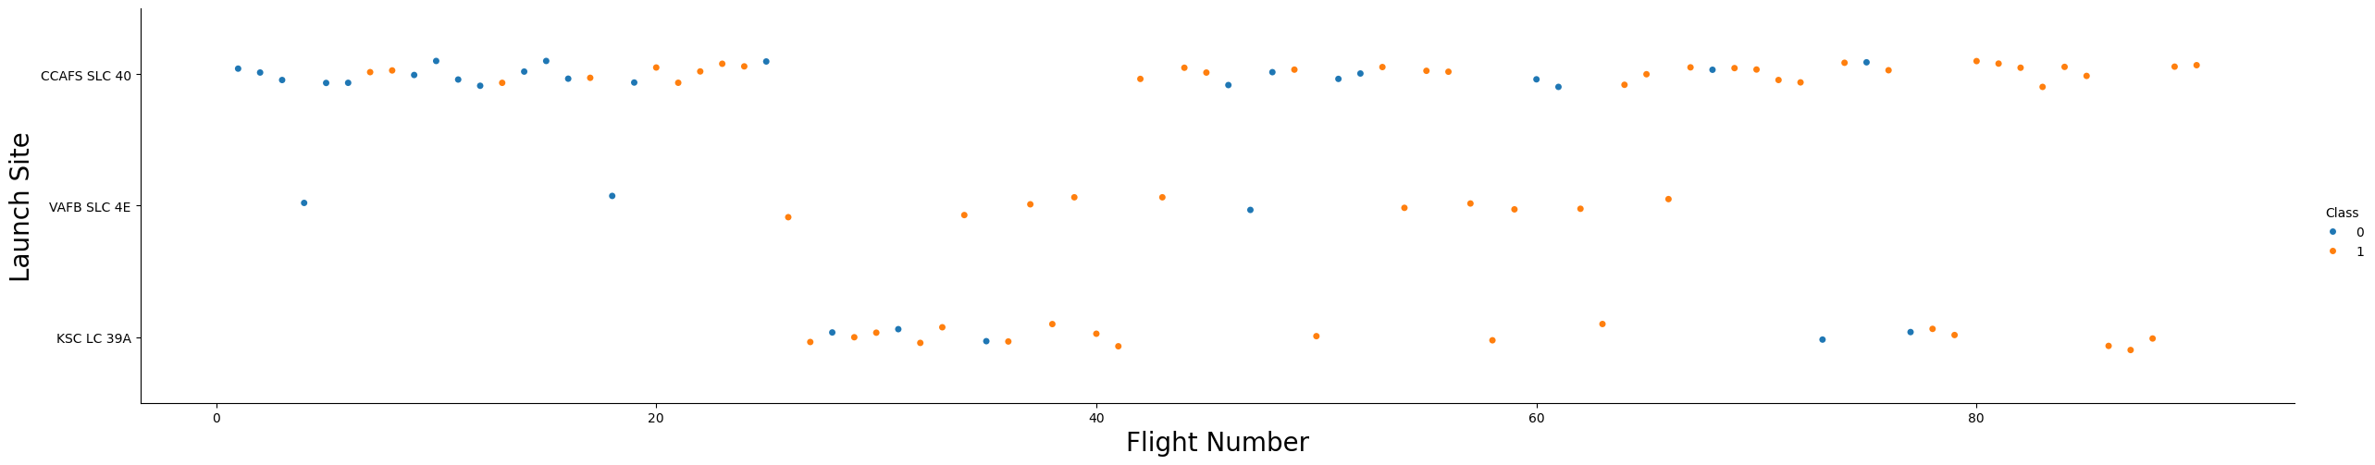
Flight Number vs. Launch Site
Success rates improved across all launch sites as flight numbers increased.
KSC LC‑39A and CCAFS SLC‑40 show higher concentrations of successful launches.
Demonstrates site‑specific performance trends and operational growth.

Slide 23
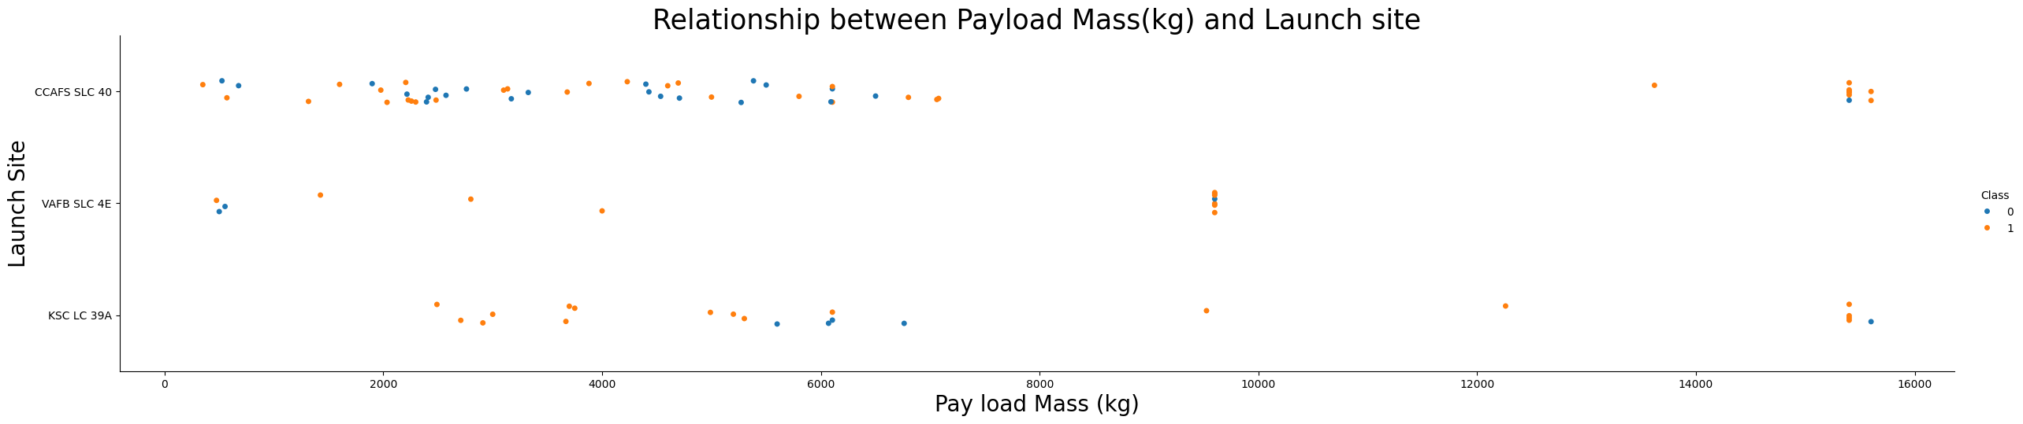
Payload vs. Launch Site
All sites handled a wide range of payloads.
KSC LC‑39A supported some of the heaviest payloads with strong success rates.
Highlights site capability and robustness with heavy missions.

Slide 24
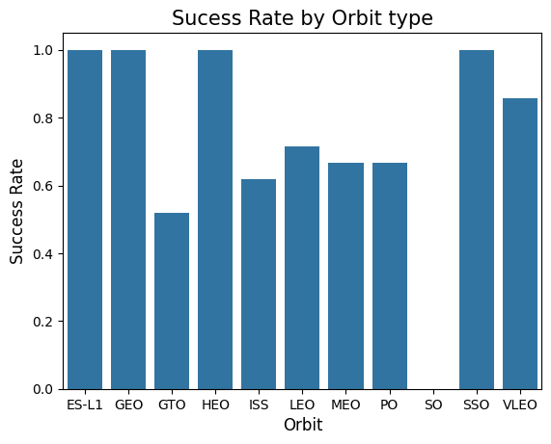
Success Rate vs. Orbit Type
Certain orbits (ES‑L1, GEO, HEO, SSO) achieved 100% success.
LEO, ISS, MEO, and PO showed moderate success ( around 60%–70%).
GTO had lower success ( around 52%), reflecting higher mission complexity.

Slide 25
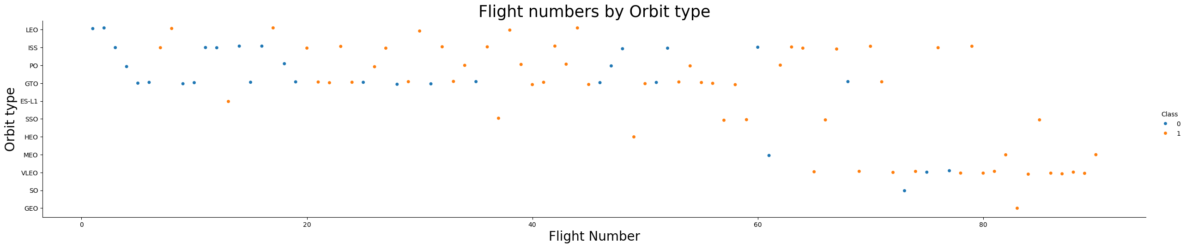
Flight Number vs. Orbit Type
Later flights show more consistent success across multiple orbit types.
LEO and ISS are the most frequent orbits, with mixed outcomes.
GEO, SSO, ES‑L1 demonstrate strong reliability even in earlier missions.

Slide 26
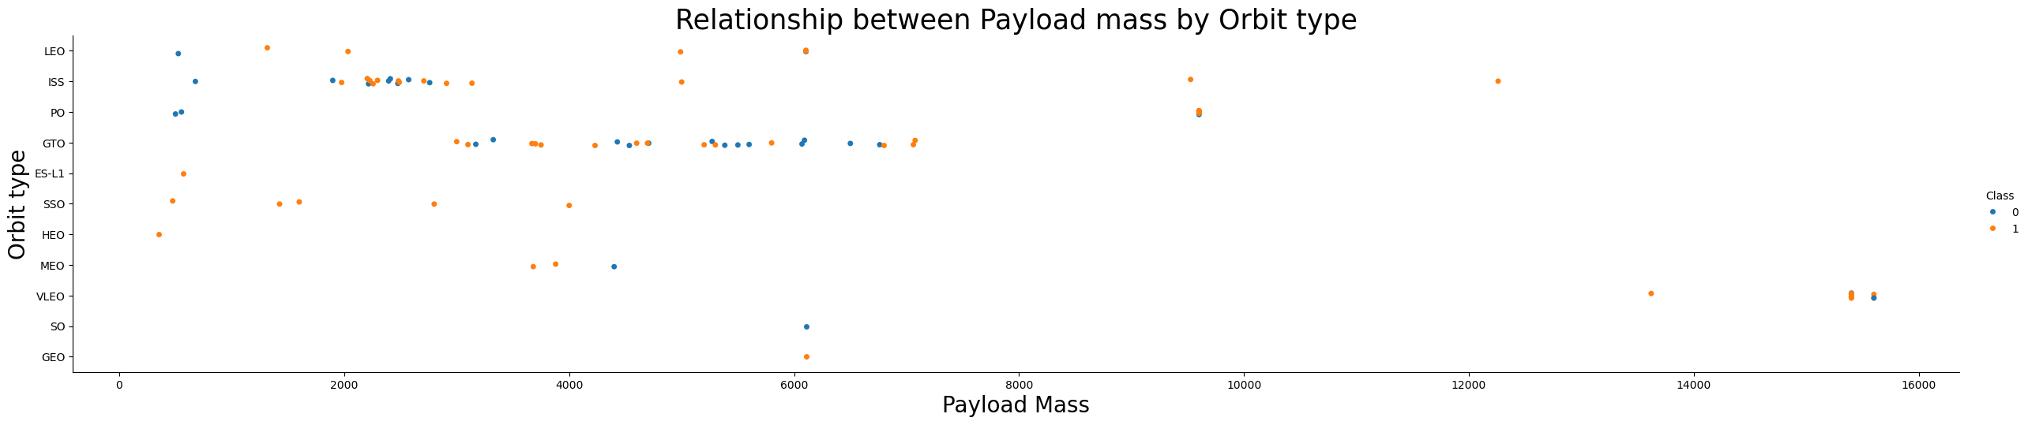
Payload vs. Orbit Type
Wide payload ranges observed across orbits, especially LEO and GTO.
Successful launches occurred across most orbit types and payload scales.
Heavy payloads were successfully delivered to complex orbits, showing operational robustness.

Slide 27
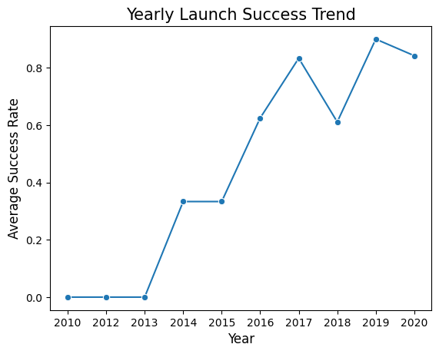
Launch Success Yearly Trend
Success rates steadily improved from 2010 to 2020.
Early years (2010–2013) had no successes.
Post‑2015 shows dramatic improvement, peaking at ~91% in 2019.
This reflects SpaceX’s evolution in reliability and booster reuse.

Slide 28
All Launch Site Names
Launch site names: CCAFS LC-40, VAFB SLC-4E, KSC LC-39A, CCAFS SLC-40
Query result:
The dataset contains four unique launch sites, which forms the basis for comparing site performance in later EDA tasks.
Launch site is a key categorical feature for predictive modeling.
Launch_Site
CCAFS LC-40
VAFB SLC-4E
KSC LC-39A
CCAFS SLC-40

Slide 29
Launch Site Names Begin with 'CCA'
5 records where launch sites begin with `CCA`
The dataset contained multiple records where launch sites began with ‘CCA’ and these correspond with Cape Canaveral Air Force sites. Cape Canaveral is one of the most frequently used launch locations, showing how important it is to SpaceX’s missions.
Date | Time (UTC) | Booster_Version | Launch_Site | Payload | PAYLOAD_MASS__KG_ | Orbit | Customer | Mission_Outcome | Landing_Outcome
2010-06-04 | 18:45:00 | F9 v1.0 B0003 | CCAFS LC-40 | Dragon Spacecraft Qualification Unit | 0 | LEO | SpaceX | Success | Failure (parachute)
2010-12-08 | 15:43:00 | F9 v1.0 B0004 | CCAFS LC-40 | Dragon demo flight C1, two CubeSats, barrel of Brouere cheese | 0 | LEO (ISS) | NASA (COTS) NRO | Success | Failure (parachute)
2012-05-22 | 7:44:00 | F9 v1.0 B0005 | CCAFS LC-40 | Dragon demo flight C2 | 525 | LEO (ISS) | NASA (COTS) | Success | No attempt
2012-10-08 | 0:35:00 | F9 v1.0 B0006 | CCAFS LC-40 | SpaceX CRS-1 | 500 | LEO (ISS) | NASA (CRS) | Success | No attempt
2013-03-01 | 15:10:00 | F9 v1.0 B0007 | CCAFS LC-40 | SpaceX CRS-2 | 677 | LEO (ISS) | NASA (CRS) | Success | No attempt

Slide 30
Total Payload Mass
Total payload carried by boosters from NASA:
The query aggregates the total payload mass (kg) for launches where the customer was NASA. The total payload mass (kg) is 45,596kg. This depicts the contributions NASA has made to SpaceX missions and provides some contextual data for payload distribution among customers and is useful for comparisons in payload totals between different agencies/commercial clients.
TOTAL_PAYLOAD_MASS
45596

Slide 31
Average Payload Mass by F9 v1.1
Average payload mass carried by booster version F9 v1.1
The query calculates the average payload mass for launches using booster version F9 v1.1. The result shows that, on average, this booster carried about 2,928 kg of payload.
This provides insight into the payload capacity and performance of the F9 v1.1 compared to other booster versions and helps us in understanding how booster technology has evolved and influenced payload delivery capabilities.
AVERAGE_PAYLOAD_MASS
2928.4

Slide 32
First Successful Ground Landing Date
Dates of the first successful landing outcome on ground pad:
The first successful landing on a ground pad occurred on December 22, 2015. This was a major milestone for SpaceX, marking the beginning of reliable booster recovery.
The achievement helped to significantly reduced launch costs and indicated the ability to reuse rocket technology.
First_Successful_Groundpad_Landing
2015-12-22

Slide 33
Successful Drone Ship Landing with Payload between 4000 and 6000
Names of boosters that have successfully landed on drone ship and had payload mass greater than 4000 but less than 6000
These boosters successfully landed on drone ships while carrying payloads between 4000–6000 kg. This result shows SpaceX’s ability to recover boosters even on challenging ocean landings with heavy payloads.
There is operational robustness in Falcon 9 boosters and a significance in drone ship landings for various missions that go beyond the ground pad range.
Booster_Version
F9 FT B1022
F9 FT B1026
F9 FT B1021.2
F9 FT B1031.2

Slide 34
Total Number of Successful and Failure Mission Outcomes
Total number of successful and failure mission outcomes
The dataset shows that the majority of SpaceX launches were successful, reflecting strong reliability.
This metric is critical for understanding overall performance and validating predictive modeling features.
Mission_Outcome | Total_Count
Failure (in flight) | 1
Success | 98
Success | 1
Success (payload status unclear) | 1

Slide 35
Boosters Carried Maximum Payload
List the names of the booster which have carried the maximum payload mass:
These boosters carried the maximum payload mass recorded and demonstrates the capability of Falcon 9 boosters in handling heavy missions.
This illustrates SpaceX’s engineering progress over time in increasing its payload capacity and is highly useful in making comparisons between booster versions to identify the best designs to support heavier launches.
Booster_Version
F9 B5 B1048.4
F9 B5 B1049.4
F9 B5 B1051.3
F9 B5 B1056.4
F9 B5 B1048.5
F9 B5 B1051.4
F9 B5 B1049.5
F9 B5 B1060.2
F9 B5 B1058.3
F9 B5 B1051.6
F9 B5 B1060.3
F9 B5 B1049.7

Slide 36
2015 Launch Records
Failed landing_outcomes in drone ship, their booster versions, and launch site names for in year 2015:
In 2015, several Falcon 9 v1.1 boosters attempted drone ship landings but failed. All the failures occurred at CCAFS LC-40. These show the challenges of ocean landings.
Month | Landing_Outcome | Booster_Version | Launch_Site
01 | Failure (drone ship) | F9 v1.1 B1012 | CCAFS LC-40
04 | Failure (drone ship) | F9 v1.1 B1015 | CCAFS LC-40

Slide 37
Rank Landing Outcomes Between 2010-06-04 and 2017-03-20
Ranked count of landing outcomes (such as Failure (drone ship) or Success (ground pad)) between the date 2010-06-04 and 2017-03-20, in descending order:
Between 2010‑06‑04 and 2017‑03‑20, the most frequent outcome was No attempt. However, there were 5 equally successful and failed drone ship outcomes, reflecting early challenges in drone ship landings. The mix of successes and failures highlights SpaceX’s learning curve during this period.
Landing_Outcome | Outcome_Count
No attempt | 10
Success (drone ship) | 5
Failure (drone ship) | 5
Success (ground pad) | 3
Controlled (ocean) | 3
Uncontrolled (ocean) | 2
Failure (parachute) | 2
Precluded (drone ship) | 1

Slide 38

Section 3

Slide 39
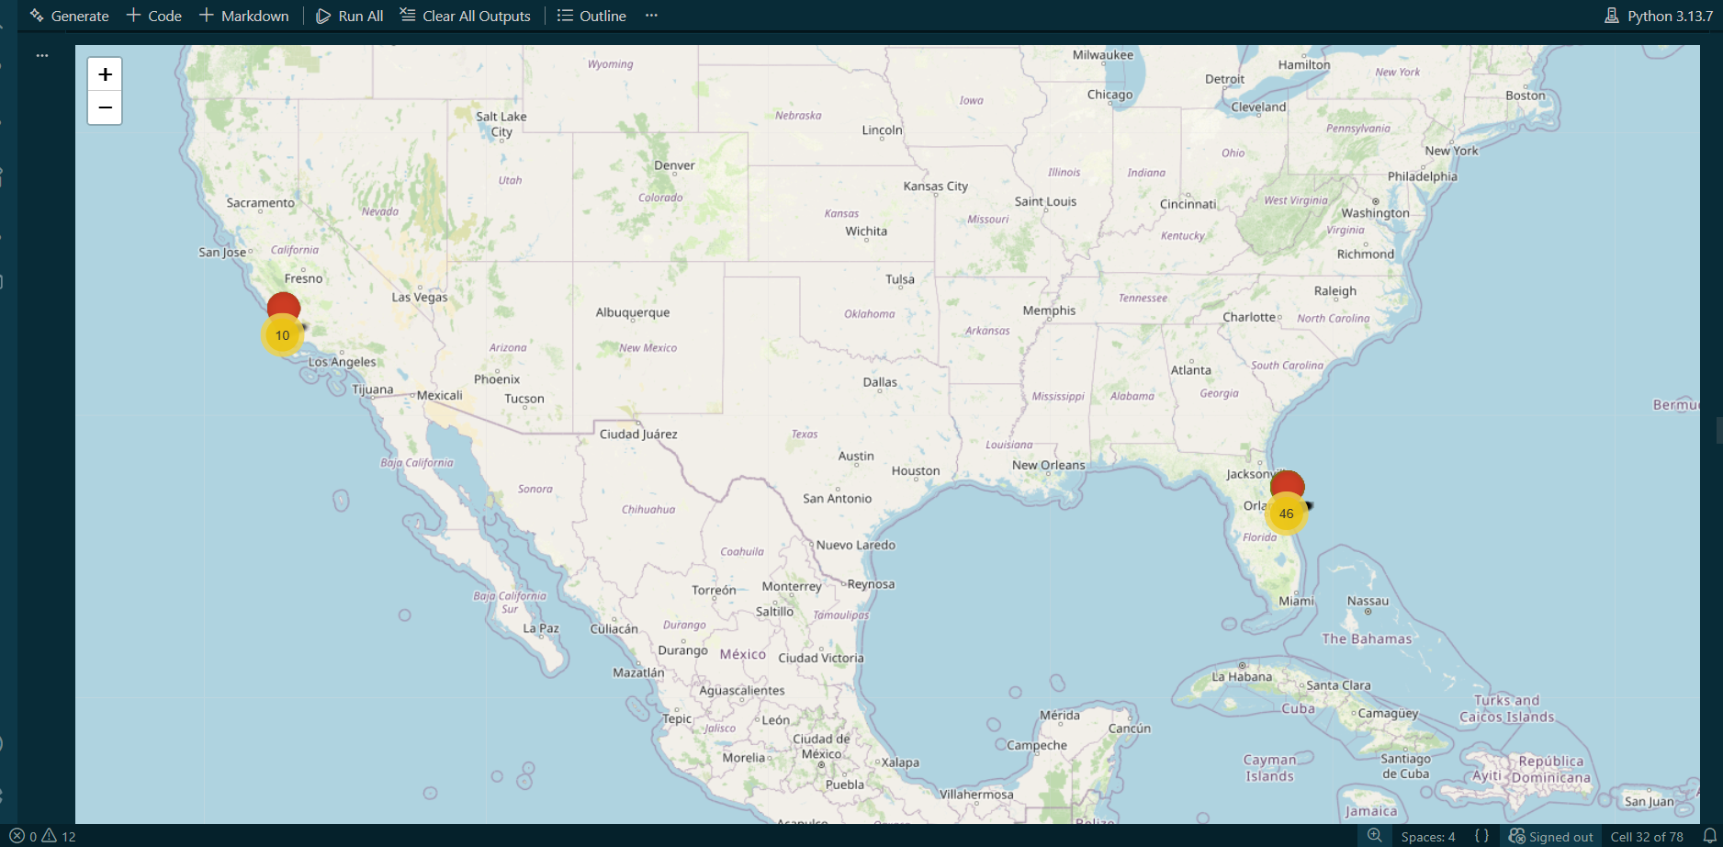
Launch sites: Visualizing SpaceX’s operational footprint

Slide 40
Launch sites: Visualizing SpaceX’s operational footprint
This folium map shows the geographic distribution of SpaceX launch sites. The Florida cluster accounts for the majority of launches (46), highlighting its role as the company’s primary launch hub. The California site (10 launches) supports missions requiring polar orbits. The map confirms that all launch activity is US-based, with Florida dominating SpaceX’s operational footprint.

Slide 41
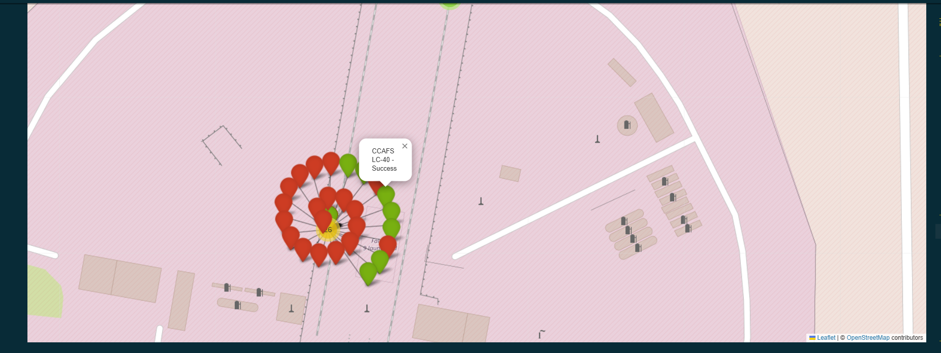
Launch Outcomes at CCAFS LC‑40

Slide 42
Launch Outcomes at CCAFS LC‑40
This folium map shows launch outcomes at CCAFS LC‑40. Each marker represents a launch event, with green indicating success and red indicating failure. The map reveals that most launches from this site were successful, highlighting SpaceX’s operational reliability at Cape Canaveral.

Slide 43
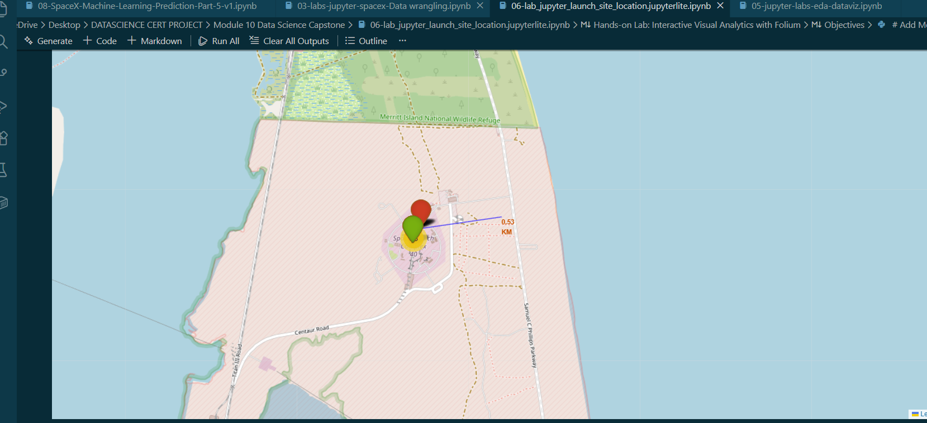
Launch Pad Location and Nearby Features

Slide 44
Launch Pad Location and Nearby Features
This folium map shows the spatial context of CCAFS LC‑40, including its proximity to roads, coastline, and natural reserves. A measured distance of 0.53 km highlights how close the launch pad is to key infrastructure, supporting operational efficiency. The site’s coastal location enables safe launch trajectories and booster recovery, while its proximity to protected areas underscores the importance of environmental stewardship.

Slide 45

Section 4

Slide 46
Launch Success Count for All Sites

Slide 47
Launch Success Count for All Sites
This pie chart shows the distribution of successful launches across SpaceX’s four main launch sites. KSC LC‑39A accounts for the largest share of successes (41.7%), followed by CCAFS LC‑40 (29.2%). The data highlights how launch site performance varies, with newer sites showing stronger reliability.

Slide 48
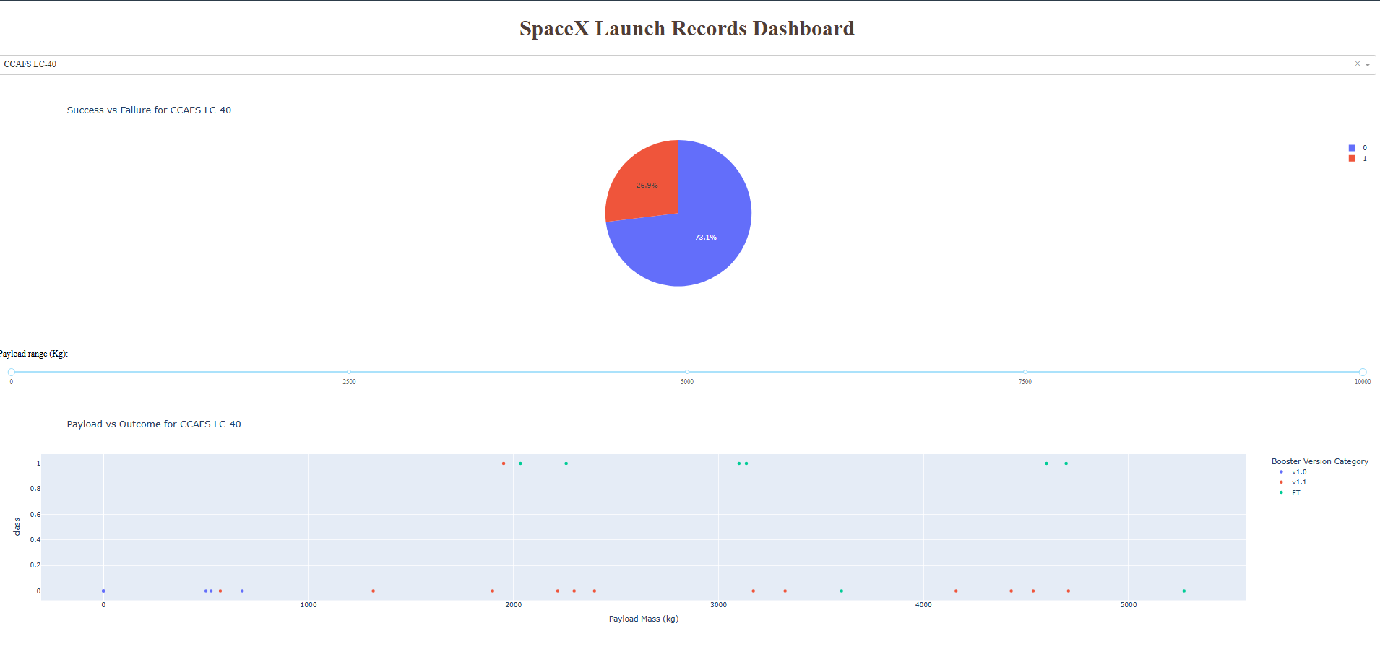
Launch Site with highest success ratio: CCAFS LC-40

Slide 49
Launch Site with highest success ratio: CCAFS LC-40
This pie chart shows launch outcomes for CCAFS LC‑40. The majority (73.1%) were successes (class= 0), while 26.9% were failures (class= 1). This reflects SpaceX’s early challenges at this site, before later improvements increased success rates.”

Slide 50
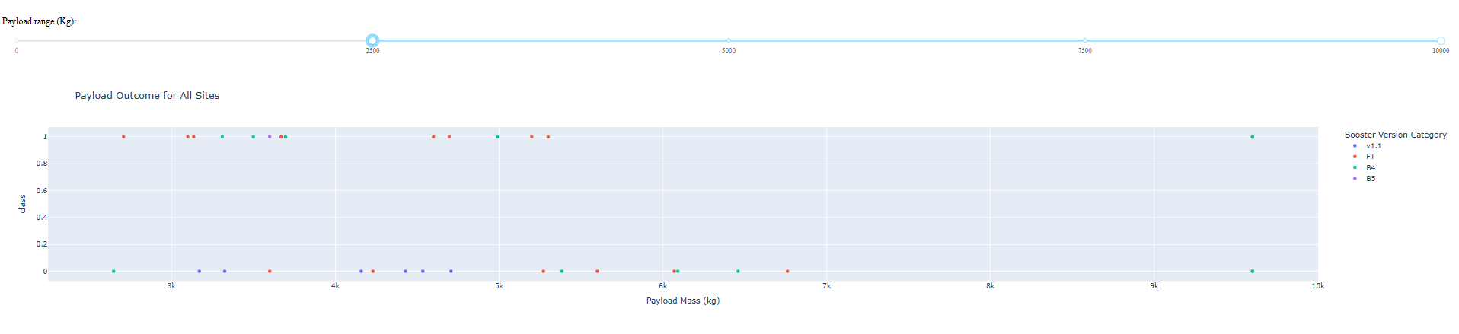
Payload vs. Launch Outcome scatter plot

Slide 51
Payload vs. Launch Outcome scatter plot
This scatter plot shows launch outcomes across all sites, filtered by payload mass. Newer boosters like FT and B5 have the highest success rates, especially with heavier payloads. Older boosters like v1.1 and B4 show more failures, reflecting SpaceX’s early development phase.

Slide 52

Section 5

Slide 53
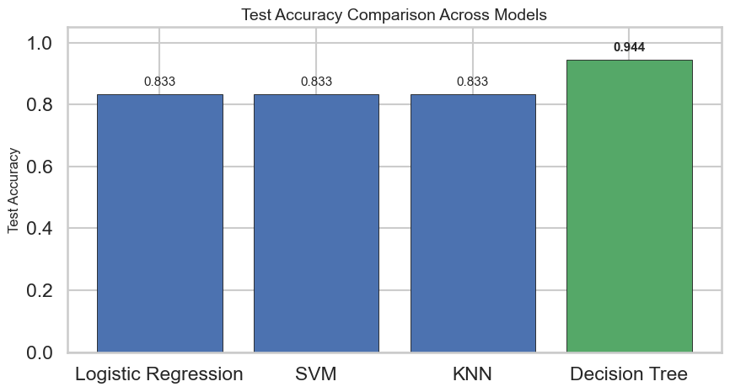
Classification Accuracy
Decision Tree has the highest test accuracy (0.9444) and is visually emphasized in the chart; the other three models tie at 0.8333.

Slide 54

Confusion Matrix
Decision Tree shows excellent performance on the test split with perfect recall, high precision, and only one false positive, making it the best performer out of all the models.

Slide 55
Conclusions
Booster version and orbit type are the strongest predictors of launch success, with newer boosters showing clear reliability gains.
Success rates improved dramatically after 2015, reflecting SpaceX’s technological maturity and booster reusability.
Florida launch sites dominate activity and successes, while California supports specialized polar missions.
Interactive dashboards and maps made success/failure patterns and site performance easy to visualize and explore.
Decision Tree Classifier achieved the highest accuracy (94%), confirming that predictive modeling can reliably forecast launch outcomes.

Slide 56
Forward‑looking Insights
Success rates post‑2015 align with booster recovery milestones. This suggests a direct link between technological innovation (reusability) and operational reliability.
Orbit success differences (e.g., GTO lower success vs. GEO/SSO near‑perfect) highlight where future engineering improvements should focus.
Decision Tree model (94% accuracy) could be extended to real‑time launch risk assessment, helping SpaceX decide whether to proceed with launches under certain conditions.
Proximity to Merritt Island National Wildlife Refuge raises questions about balancing launch activity with ecological preservation.

Slide 57
Appendix
Github Repository:
Main page: https://github.com/beclyv/Data_Science_Capstone_Project_SpaceX
Data: https://github.com/beclyv/Data_Science_Capstone_Project_SpaceX/tree/main/data
Maps: https://github.com/beclyv/Data_Science_Capstone_Project_SpaceX/tree/main/folium%20maps
Jupyter notebooks: https://github.com/beclyv/Data_Science_Capstone_Project_SpaceX/tree/main/notebooks
Project dependencies: https://github.com/beclyv/Data_Science_Capstone_Project_SpaceX/tree/main/requirements.txt
Plotly dashboard snapshots: https://github.com/beclyv/Data_Science_Capstone_Project_SpaceX/tree/main/results

Slide 58


